Slide 1
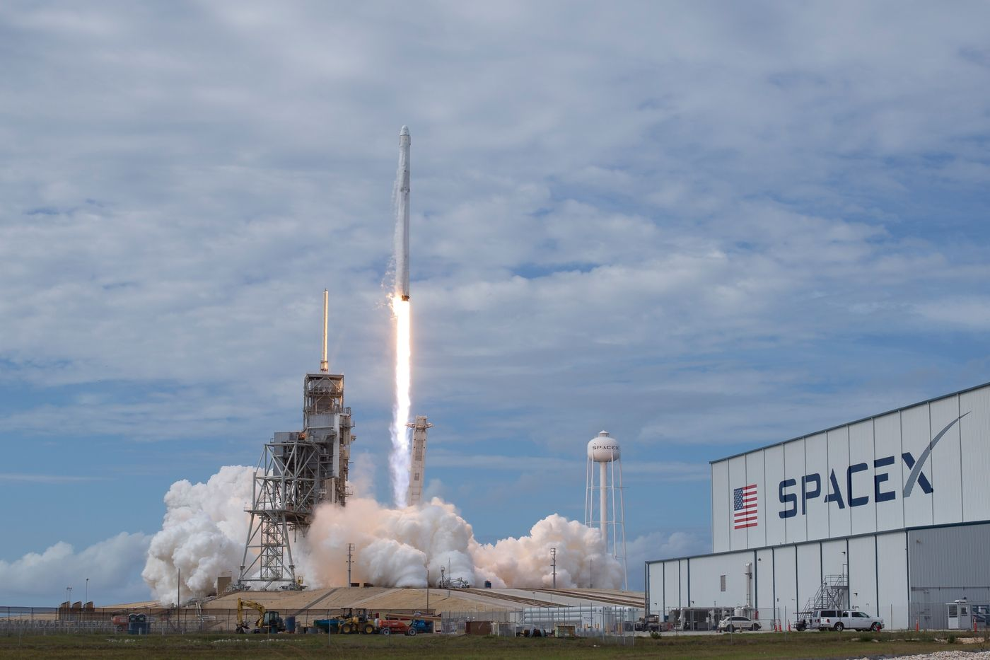
winning space race with data science
KABA Alpha Mohamed
20 mai 2022

Slide 2

Outline
Executive Summary
Introduction
Methodology
Results
Conclusion
References

Slide 3
Executive Summary
Summary of methodologies
Data Collection through API
Data Collection with Web Scraping
Data Wrangling
Exploratory Data Analysis with SQL
Exploratory Data Analysis with Data Visualization
Interactive Visual Analytics with Folium
Machine Learning Prediction
Summary of all results
Exploratory Data Analysis result
Interactive analytics in screenshots
Predictive Analytics result

Slide 4
Introduction
Project background and context
Space X advertises Falcon 9 rocket launches on its website with a cost of 62 million dollars; other providers cost upward of 165 million dollars each, much of the savings is because Space X can reuse the first stage. Therefore, if we can determine if the first stage will land, we can determine the cost of a launch. This information can be used if an alternate company wants to bid against space X for a rocket launch. This goal of the project is to create a machine learning pipeline to predict if the first stage will land successfully.
Problems you want to find answers
What factors determine if the rocket will land successfully?
The interaction amongst various features that determine the success rate of a successful landing.
What operating conditions needs to be in place to ensure a successful landing program.

Slide 5


Slide 6
Methodology
Executive Summary
Data collection methodology:
Make requests to the SpaceX API.
Perform web scraping to collect Falcon 9 historical launch records on the Wikipedia page titled: List of Falcon 9 and Falcon Heavy launches
Perform data wrangling
Clean the data and explore it to find patterns in the data to determine the labels for training supervised models.
Perform exploratory data analysis (EDA) using visualization and SQL
Perform interactive visual analytics using Folium and Plotly Dash
Perform predictive analysis using classification models
Create a machine learning pipeline to predict if the first stage will land given the data.
Train the best performing model to make accurate predictions.

Slide 7
Data Collection
The data was collected using various methods
Data collection was done using get request to the SpaceX API.
Next, we decoded the response content as a Json using .json() function call and turn it into a pandas dataframe using .json_normalize().
We then cleaned the data, checked for missing values and fill in missing values where necessary.
In addition, we performed web scraping from Wikipedia for Falcon 9 launch records with BeautifulSoup.
The objective was to extract the launch records as HTML table, parse the table and convert it to a pandas dataframe for future analysis.

Slide 8
Data Collection – SpaceX API
Make request to SpaceX API
Decode the response content as a Json
Turn Json into pandas data frame
Use the API again to get information about the launches using the IDs given for each launch
Construct our dataset using the data we have obtained
Filter the dataframe to only include Falcon 9 launches
Replace null values in the data with the mean that was calculated
Convert data frame into a CSV dataset
Make a request to SpaceX API and make sure the data is in the correct format.
Perform some basic data wrangling and formatting in order to clean the requested data.
Convert our data frame into a CSV dataset.
URL link: https://github.com/alpha970/Data_Science_Capstone/blob/main/jupyter-labs-spacex-data-collection-api%20(4).ipynb

Slide 9
Data Collection - Web Scraping
Request the Falcon9 Launch Wiki page from its URL
Create a BeautifulSoup object from the HTML respone
Extract all column/variable names from the HTML table header
Create an empty dictionary with keys from the extracted column names
Fill up the dictionary with launch records extracted from table rows.
Convert the dictionary into a CSV dataset
Using BeautifulSoup, perform web scraping on the wikipedia page with title: List of Falcon 9 and Falcon Heavy launches
Store the launch records in an HTML table.
Parse the table and convert it into a CSV dataset.
URL link: https://github.com/alpha970/Data_Science_Capstone/blob/main/jupyter-labs-webscraping.ipynb

Slide 10

Data Wrangling
We performed exploratory data analysis and determined the training labels.
We calculated the number of launches at each site, and the number and occurrence of each orbits
We created landing outcome label from outcome column and exported the results to csv.
The link to the notebook is https://github.com/alpha970/Data_Science_Capstone/blob/main/labs-jupyter-spacex-Data%20wrangling.ipynb

Slide 11
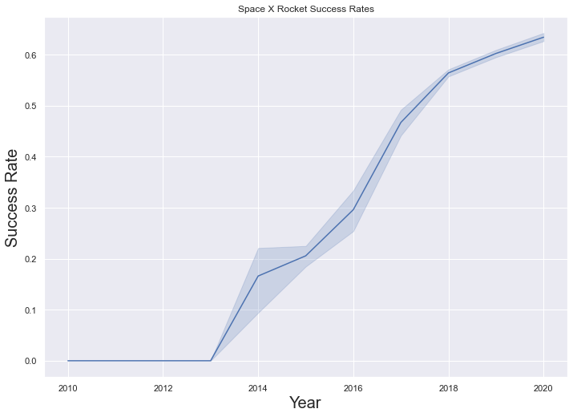
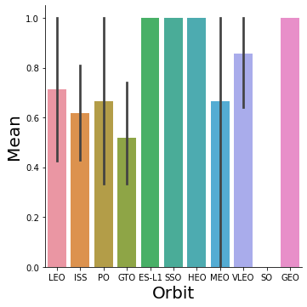
EDA with Data Visualization
We explored the data by visualizing the relationship between flight number and launch Site, payload and launch site, success rate of each orbit type, flight number and orbit type, the launch success yearly trend.
The link to the notebook is https://github.com/alpha970/Data_Science_Capstone/blob/main/jupyter-labs-eda-dataviz.ipynb

Slide 12
EDA with SQL
We loaded the SpaceX dataset into a PostgreSQL database without leaving the jupyter notebook.
We applied EDA with SQL to get insight from the data. We wrote queries to find out for instance:
The names of unique launch sites in the space mission.
The total payload mass carried by boosters launched by NASA (CRS)
The average payload mass carried by booster version F9 v1.1
The total number of successful and failure mission outcomes
The failed landing outcomes in drone ship, their booster version and launch site names.
The link to the notebook is: https://github.com/alpha970/Data_Science_Capstone/blob/main/jupyter-labs-eda-sql-coursera.ipynb

Slide 13
Build an Interactive Map with Folium
We marked all launch sites, and added map objects such as markers, circles, lines to mark the success or failure of launches for each site on the folium map.
We assigned the feature launch outcomes (failure or success) to class 0 and 1.i.e., 0 for failure, and 1 for success.
Using the color-labeled marker clusters, we identified which launch sites have relatively high success rate.
We calculated the distances between a launch site to its proximities. We answered some question for instance:
Are launch sites near railways, highways and coastlines.
Do launch sites keep certain distance away from cities.
https://github.com/alpha970/Data_Science_Capstone/blob/main/lab_jupyter_launch_site_location.ipynb

Slide 14
Build a Dashboard with Plotly Dash
We built an interactive dashboard with Plotly dash
We plotted pie charts showing the total launches by a certain sites
We plotted scatter graph showing the relationship with Outcome and Payload Mass (Kg) for the different booster version.
The link to the notebook is https://github.com/alpha970/Data_Science_Capstone/blob/main/spacex_app.py

Slide 15
Predictive Analysis (Classification)
We loaded the data using numpy and pandas, transformed the data, split our data into training and testing.
We built different machine learning models and tune different hyperparameters using GridSearchCV.
We used accuracy as the metric for our model, improved the model using feature engineering and algorithm tuning.
We found the best performing classification model.
The link to the notebook is: https://github.com/alpha970/Data_Science_Capstone/blob/main/SpaceX_Machine%20Learning%20Prediction_Part_5.ipynb

Slide 16
Results
Exploratory data analysis results
Interactive analytics demo in screenshots
Predictive analysis results

Slide 17


Slide 18
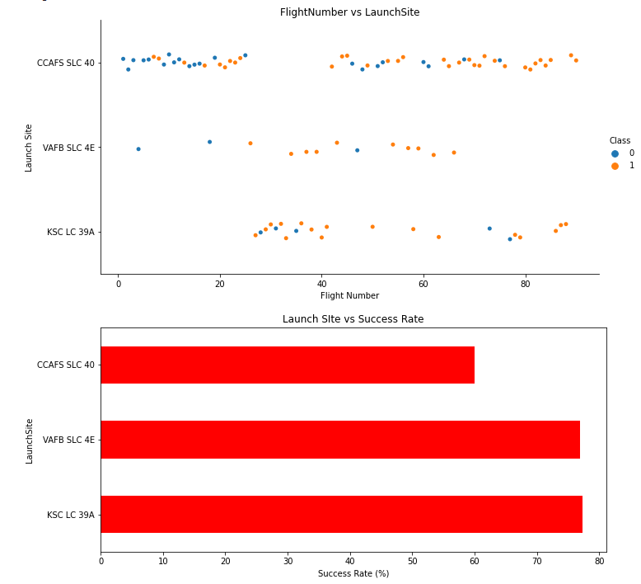
Flight Number vs. Launch Site
It appears that there were more successful landings as the flight numbers increased. It also seems that launch site CCAFS SLC 40 had the most number of landing attempts while the site VAFB SLC 4E had the least number of attempts.
Looking at the second chart, we can see that there is no Launch Site with a success rate below 60%.

Slide 19
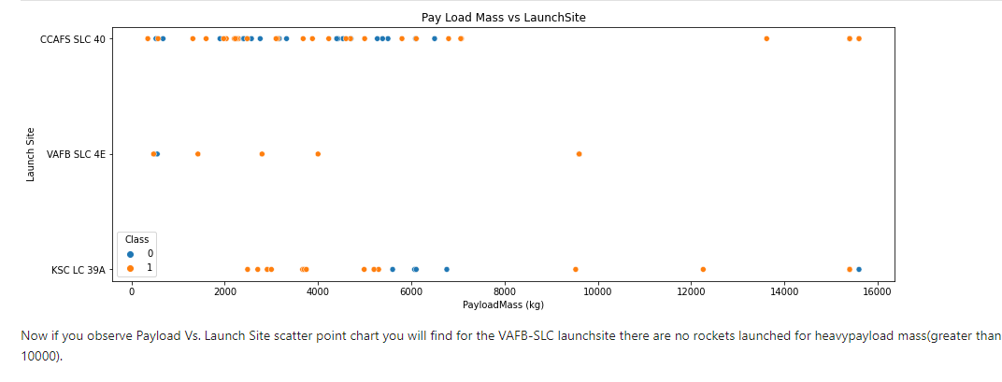
Payload vs. Launch Site
Now if you observe the scatter point chart, you will find for the VAFB-SLC launch site there are no rockets launched for heavy payload mass(greater than 10000).

Slide 20
Success Rate vs. Orbit Type
From the plot, we can see that ES-L1, GEO, HEO, SSO, VLEO had the most success rate.

Slide 21
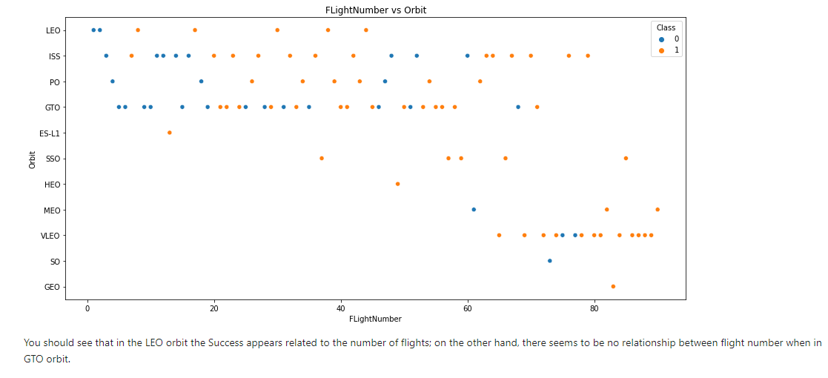
Flight Number vs. Orbit Type
You can see that in the LEO orbit the Success appears related to the number of flights; on the other hand, there seems to be no relationship between flight number when in GTO orbit.

Slide 22
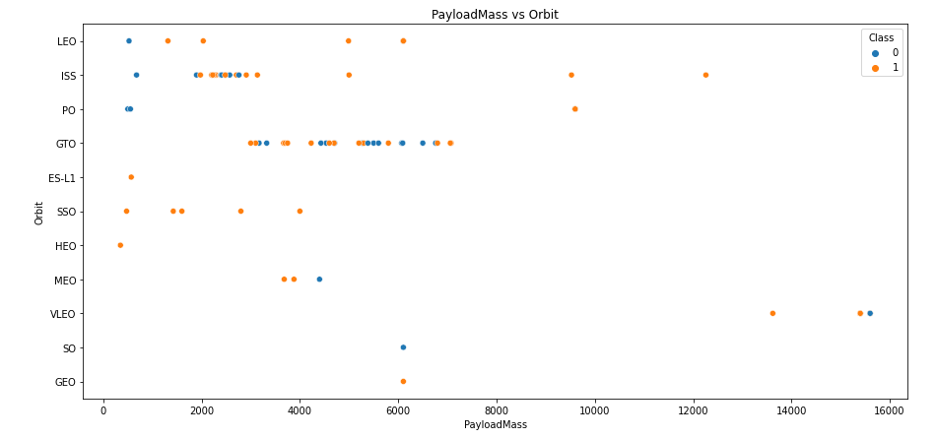
Payload vs. Orbit Type
With heavy payloads the successful landing or positive landing rate are more for Polar, LEO and ISS.
However for GTO we cannot distinguish this well as both positive landing rate and negative landing(unsuccessful mission) are both there.

Slide 23
Launch Success Yearly Trend
From the plot, we can observe that success rate since 2013 kept on increasing till 2020.

Slide 24
All Launch Site Names
Given the data, these are the names of the launch sites where different rocket landings where attempted:
CCAFS LC-40
CCAFS SLC-40
KSC LC-39A
VAFB SLC-4E

Slide 25
Launch Site Names Beginning with 'CCA'
Date | Launch_Site | Orbit | Customer | Mission_Outcome | Landing_Outcome
04-06-2010 | CCAFS LC-40 | LEO | SpaceX | Success | Failure (parachute)
08-12-2010 | CCAFS LC-40 | LEO (ISS) | NASA (COTS) NRO | Success | Failure (parachute)
22-05-2012 | CCAFS LC-40 | LEO (ISS) | NASA (COTS) | Success | No attempt
08-10-2012 | CCAFS LC-40 | LEO (ISS) | NASA (CRS) | Success | No attempt
01-03-2013 | CCAFS LC-40 | LEO (ISS) | NASA (CRS) | Success | No attempt
These are 5 records where launch sites begin with the letters 'CCA'. As we can see, there are other organizations besides SpaceX that were testing their rockets.

Slide 26
Total Payload Mass
The information in the table displays the total payload mass carried by boosters launched by NASA .
It seems that NASA (CRS) had a significantly higher total payload mass compared to the rest.
Customer | Total_Payload_Mass
NASA (CRS) | 45596
NASA (CCDev) | 12530
NASA (CCP) | 12500
NASA (CCD) | 12055
NASA (CTS) | 12050
NASA (CRS), Kacific 1 | 2617
NASA / NOAA / ESA / EUMETSAT | 1192
NASA (LSP) NOAA CNES | 553
NASA (COTS) | 525
NASA (LSP) | 362
NASA (COTS) NRO | 0

Slide 27
Average Payload Mass by F9 v1.1
Average_Payload_Mass (kg) | Booster_Version
2928.4 | F9 v1.1
The average payload mass carried by F9 v1.1 was 2928.4 kg.

Slide 28
First Successful Ground Landing Date
Date | Landing_Outcome
22-12-2015 | Success (ground pad)
The first successful ground pad landing took place in December 2015. This was a historic reusable-rocket milestone for both SpaceX and the world.
Prior to this, no one had ever brought an orbital class booster back intact.

Slide 29
Successful Drone Ship Landing with Payload between 4000 and 6000
Booster_Version | PAYLOAD_MASS__KG_ | Landing_Outcome
F9 FT B1022 | 4696 | Success (drone ship)
F9 FT B1026 | 4600 | Success (drone ship)
F9 FT B1021.2 | 5300 | Success (drone ship)
F9 FT B1031.2 | 5200 | Success (drone ship)
It appears that there only 4 Boosters with a payload mass between 4000 and 6000.
It is interesting to see that they all had successful landing outcomes.

Slide 30
Total Number of Successful and Failure Mission Outcomes
Mission_Outcome | Outcomes
Failure (in flight) | 1
Success | 99
Success (payload status unclear) | 1
It appears that missions generally tend to be successful with the exception of one failure.

Slide 31
Boosters That Carried the Maximum Payload Mass
12 boosters have carried the maximum payload mass of 15600 kg.
Since the version names are similar, they might be from the same manufactures.
Booster_Version | PAYLOAD_MASS__KG_
F9 B5 B1048.4 | 15600
F9 B5 B1049.4 | 15600
F9 B5 B1051.3 | 15600
F9 B5 B1056.4 | 15600
F9 B5 B1048.5 | 15600
F9 B5 B1051.4 | 15600
F9 B5 B1049.5 | 15600
F9 B5 B1060.2 | 15600
F9 B5 B1058.3 | 15600
F9 B5 B1051.6 | 15600
F9 B5 B1060.3 | 15600
F9 B5 B1049.7 | 15600

Slide 32
2015 Launch Records - Failed Landing Outcomes
Date | Launch_Site | Booster_Version | Landing_Outcome
10-01-2015 | CCAFS LC-40 | F9 v1.1 B1012 | Failure (drone ship)
14-04-2015 | CCAFS LC-40 | F9 v1.1 B1015 | Failure (drone ship)
It appears that 2 boosters failed to land at the beginnnig of the year..
The first successful landing took place later that year in December as we saw earlier.

Slide 33
Rank Landing Outcomes Between 2010-06-04 and 2017-03-20
If we observe the table, it is apparent that the number of successful landings have increased since 2015.
Before 2013, it seems that there were no attempts to land the boosters.
_date_ | Landing_Outcome | Outcomes
2016-04-08 | Success (drone ship) | 14
2015-12-22 | Success (ground pad) | 9
2015-06-28 | Precluded (drone ship) | 1
2015-01-10 | Failure (drone ship) | 5
2014-04-18 | Controlled (ocean) | 5
2013-09-29 | Uncontrolled (ocean) | 2
2012-05-22 | No attempt | 22

Slide 34


Slide 35

All launch sites global map markers

Slide 36

Markers showing launch sites with color labels

Slide 37

Launch Site distance to landmarks

Slide 38


Slide 39

Pie chart showing the success percentage achieved by each launch site

Slide 40

Pie chart showing the Launch site with the highest launch success ratio

Slide 41

Scatter plot of Payload vs Launch Outcome for all sites, with different payload selected in the range slider

Slide 42


Slide 43
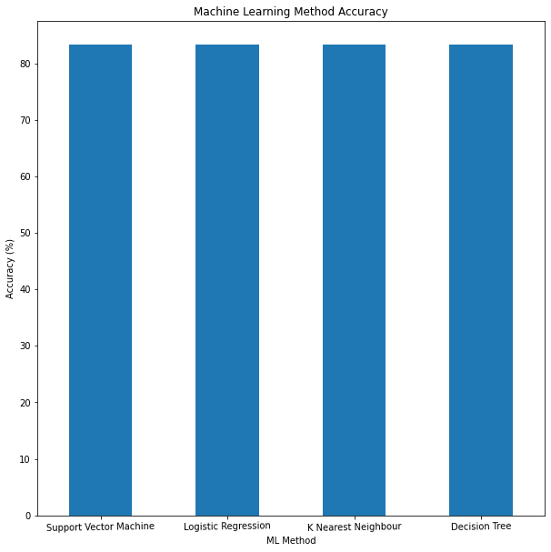
Classification Accuracy
Since all the methods have an identical accuracy score of 83.33%, we decided to use Logistic Regression for the classification

Slide 44
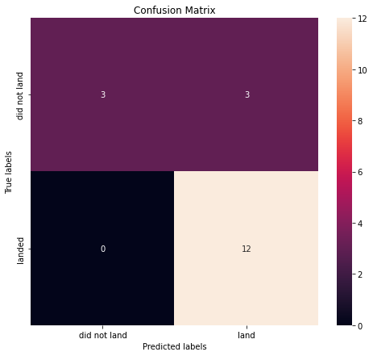
Confusion Matrix
The chart shows the confusion matrix of the Logistic Regression model that was chosen.
The model only failed to accurately predict 3 labels.

Slide 45
Conclusions
In order to compete with SpaceX, it was crucial to analyze their data. Through this process, a general picture of their success methods was produced.
All their launch sites are located near the coast, away from nearby cities. This enabled to them to test their rocket landings without much interference.
Site KSC LC-39A had the highest launch success rate out of all the launch sites.
From 2015 onwards, the success rate of rocket landings significantly increased. It was also apparent that landing success increased with flight number
All this data was used to train a machine learning model that is able to predict the landing outcome of rocket launches with 83.33% accuracy.
This will allow our company to make more attractive offers than SpaceX and increase the confidence of our investors and customers. Can anyone say “No” to a company that can predict the success of their product?

Slide 46
References
Fortune Business Insights (2020). Space launch services market. https://www.fortunebusinessinsights.com/industry-reports/space-launch-services-market-101931
CB Insights. The Top 12 Reasons Startups Fail. https://www.cbinsights.com/research/startup-failure-reasons-top/
IBM. Data Science Professional Certificate. https://www.coursera.org/professional-certificates/ibm-data-science
Space.com. SpaceX Lands Orbital Rocket Successfully in Historic First. https://www.space.com/31420-spacex-rocket-landing-success.html

Slide 47


